Slide 1
Quiz Night!
Notes:
6 sections with bonus scavenger hunts followed by general knowledge

Slide 2
Name that emoji

Slide 3
Emojis
Face with tears of joy
Loudly crying face
Rolling on floor laughing

Slide 4
Emojis
Sad face
Puppy eyes face
Pleading face

Slide 5
Emojis
Night
Dizzy
Sparkles

Slide 6
Emojis
Dizzy face
Zany face
Funny face

Slide 7
Emojis
Tired face
Frustrated face
Sad face

Slide 8
Scavenger Hunt
Rainbow

Slide 9
TV and Films

Slide 10
TV and Films

Slide 11
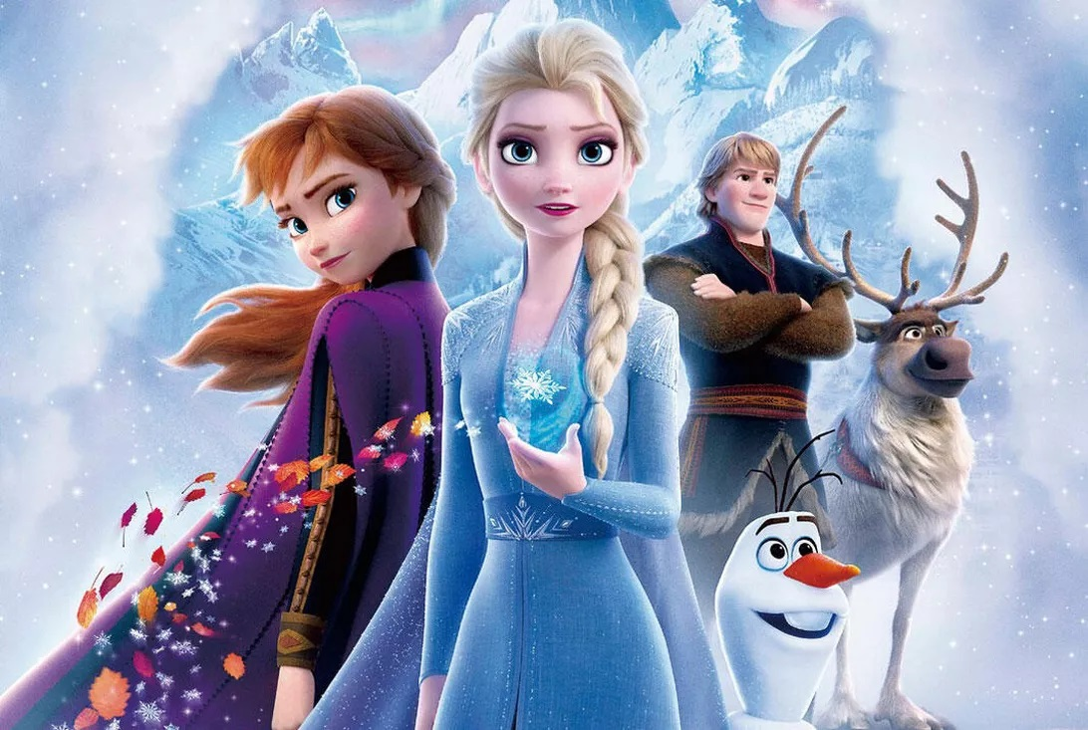
TV and Films

Slide 12
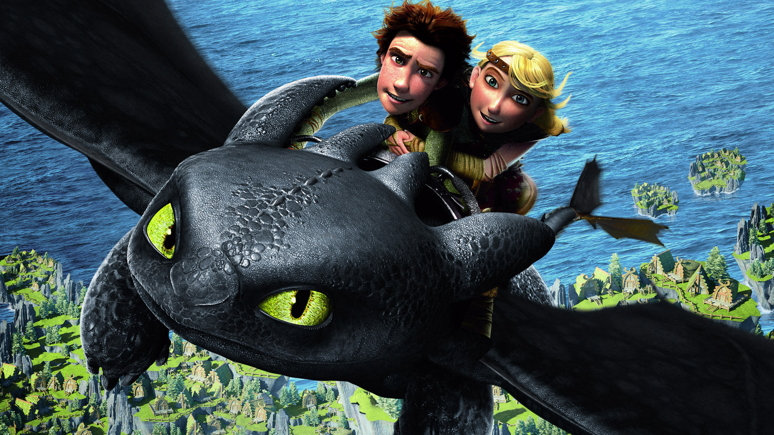
TV and Films

Slide 13
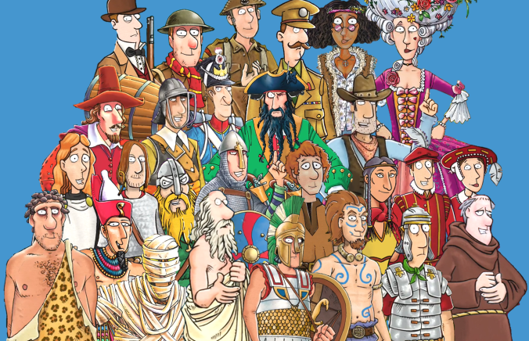
TV and Films

Slide 14
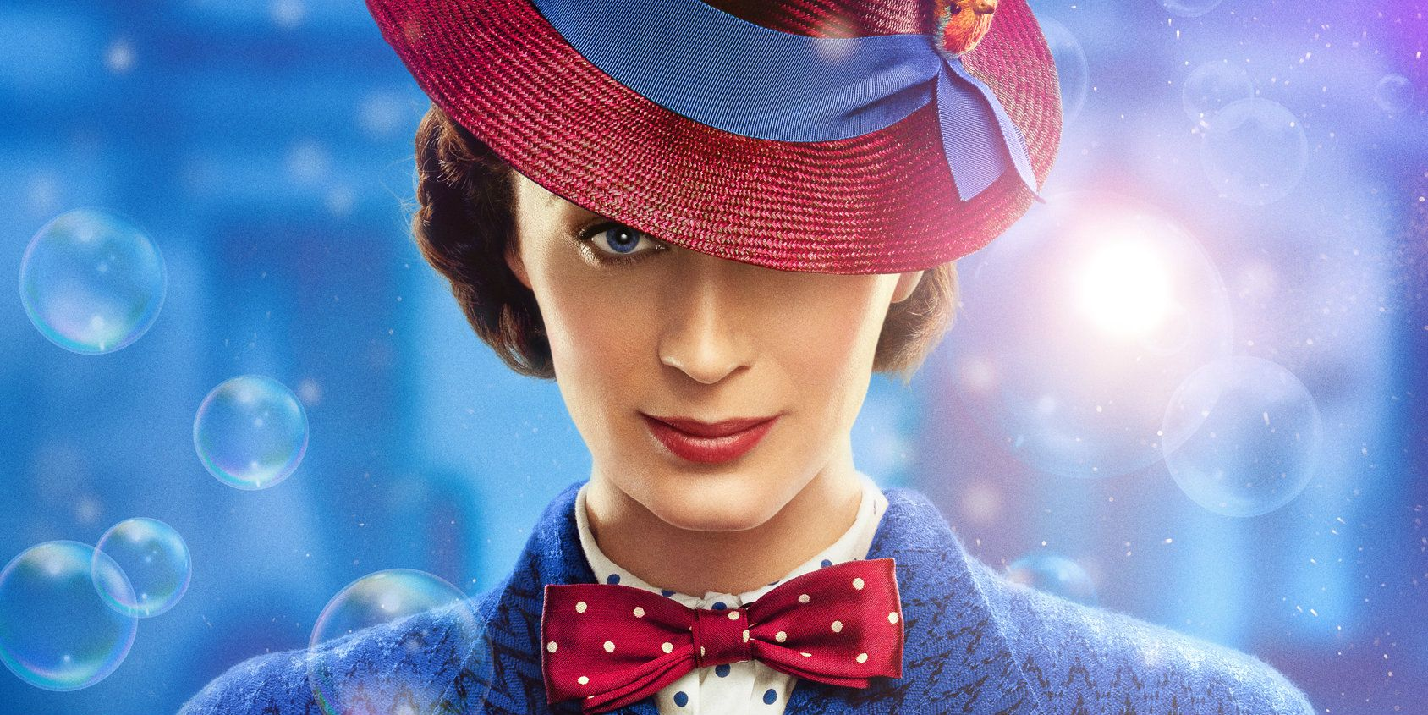
TV and Films

Slide 15
Scavenger Hunt
Something Comforting

Slide 16
Answer smash

Slide 17
Programme themes

Slide 18
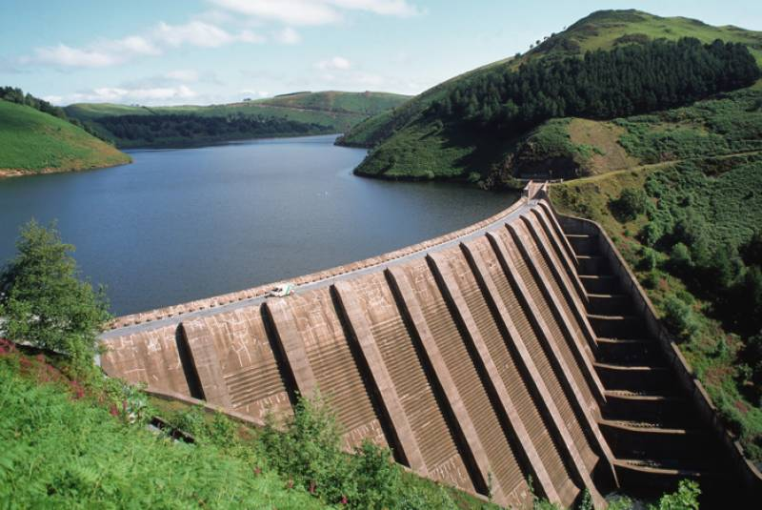
Answer smash
Example
Have Adventures
Reservoir
Have AdventuReservoir

Slide 19
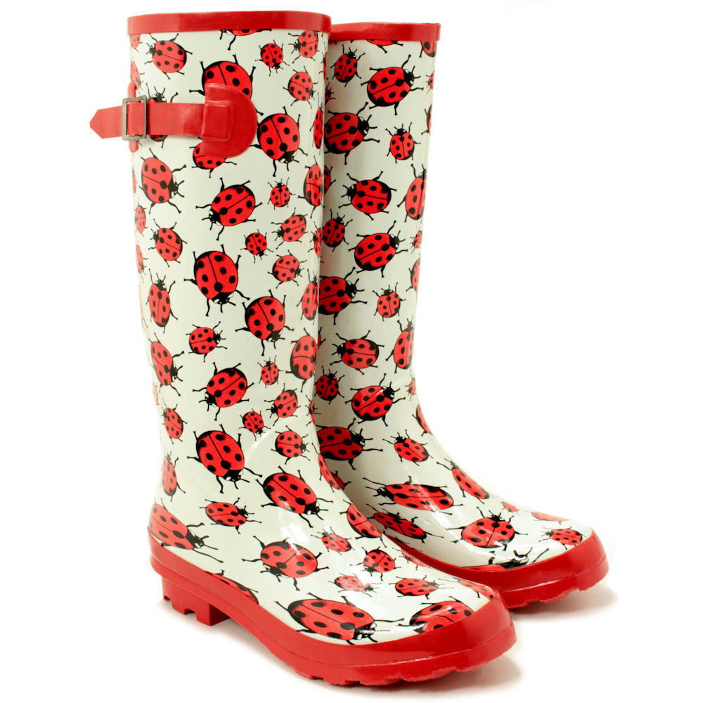
Answer smash

Slide 20
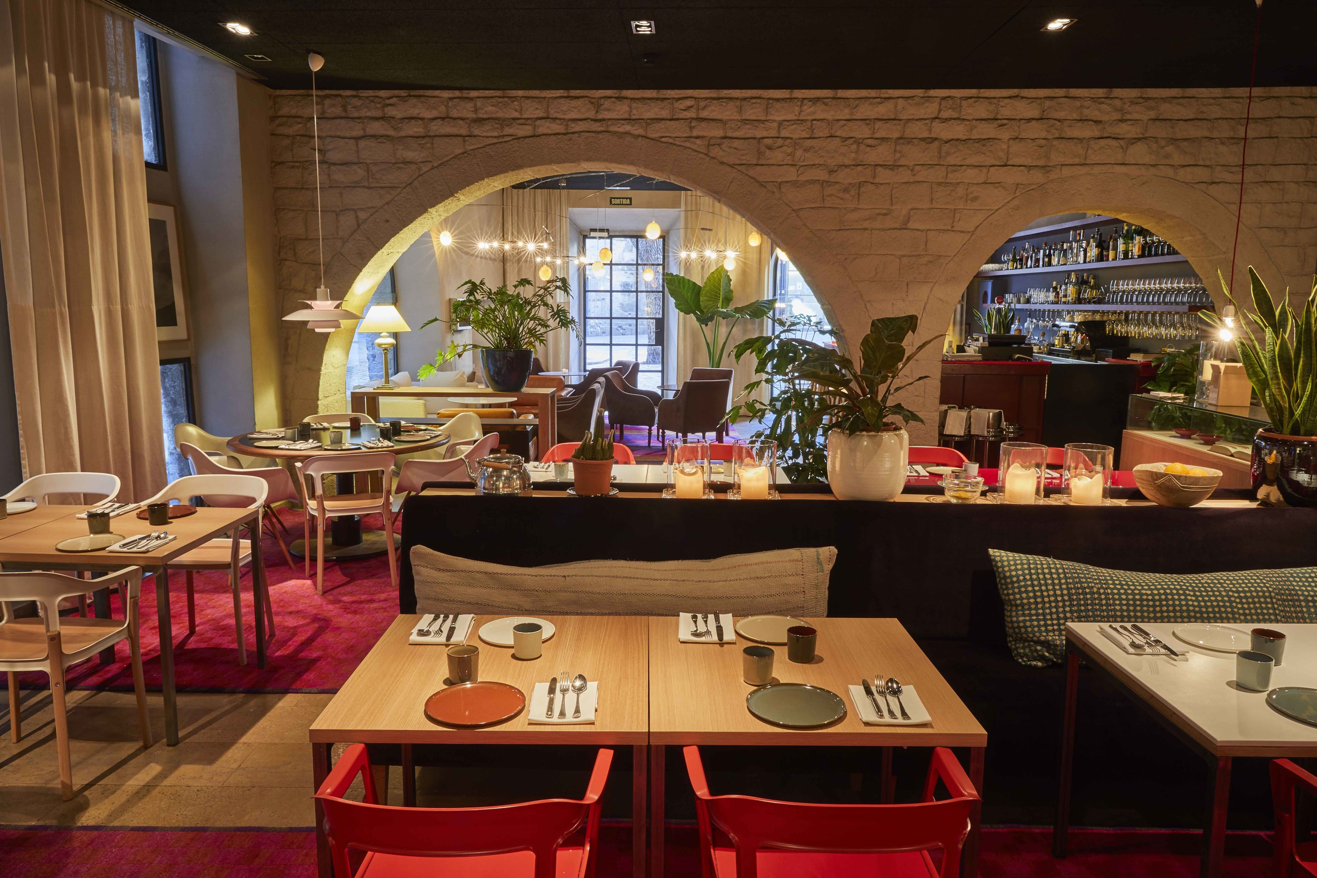
Answer smash

Slide 21
Answer smash

Slide 22
Scavenger Hunt
Something Magical

Slide 23
Guide Camp Anagrams

Slide 24
Guide Camp Anagrams
neTt
Biplane eggS
A bride
Cave Stomping
esCaping formS

Slide 25
Scavenger Hunt
Something Old

Slide 26
Where in the world?

Slide 27
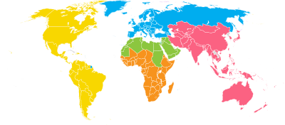
Where in the world?
1 point for the correct continent
1 point for the correct country
Pax Lodge
Our Chalet
Our Cabana
Kusafiri
Sangam

Slide 28
Scavenger Hunt
Something from another country

Slide 29
Music

Slide 30
Music
Name the members of the pop group Little Mix

Slide 31
Music
Reginald Kenneth Dwight is better known by what name?

Slide 32
Music
Who sings the James Bond theme track for the film No Time to Die?

Slide 33
Music
Which former One Direction member released ‘Watermelon Sugar’ and ‘Adore You’?

Slide 34
Music
Which male artist headlined at Glastonbury in 2019?

Slide 35
Scavenger Hunt
Something that makes music

Slide 36
General Knowledge

Slide 37
Insert any additional question here

Slide 38
Answers

Slide 39
Emojis
Face with tears of joy
c) Pleading face
c) Sparkles
b ) Zany face
Tired face

Slide 40
TV and Films
Blue Peter
Frozen 2
How to train a dragon
Horrible Histories
Mary Poppins Returns

Slide 41
Answer smash
Be Wellington boot
Have AdventuRestaurant
Know MySelfie stick

Slide 42
Guide Camp Anagrams
Nett – tent
Biplane eggs (SB) – sleeping bag
A bride – airbed
Cave stomping (CS) – camping stove
Escaping forms (CS) - campfire songs

Slide 43
Where in the world?
1 point for the correct continent
1 point for the correct country
Pax Lodge – Europe – London, UK
Our Chalet – Europe – Adelboden, Switzerland
Our Cabana – America – Cuernavaca, Mexico
Kusafiri – Africa (moving)
Sangam - Asia – Pune, India

Slide 44
Music Answers
Name the members of the pop group Little Mix
(1 point for each)
Jessy, Leigh-Anne, Perrie, Jade
Elton John
Reginald Kenneth Dwight is better known by what name?
Who sings the James Bond theme track for the film No Time to Die?
Billie Eilish
Which former One Direction member released ‘Watermelon Sugar’ and ‘Adore You’?
Harry Styles
Which male artist headlined at Glastonbury in 2019?
Stormzy

Slide 45
General Knowledge Answers

Slide 46
Scores

